Slide 1
DLA To-Do List More than one slide…be sure to read all!!!!
Solidify your theme idea and statement. The wording can be revised, but the idea should be decided upon.
Make sure your literary devices can be used to support the development of your theme.
READ, READ, and READ again—the script instructions, the assignment instructions (which outline what to do for slides), and the rubric.
View the student model and example “Flushie” script when in doubt.

Slide 2
DLA To-Do List continued…
Find “free use” pictures and cite them. Read the rubric and assignment to pick appropriate images.
http://www.photosforclass.com/ This site puts the citation right on the picture for you!
Gale Cengage Databases: http://www.fortbendisd.com//site/Default.aspx?PageID=961
See instructions for using Gale on the following slides.

Slide 3
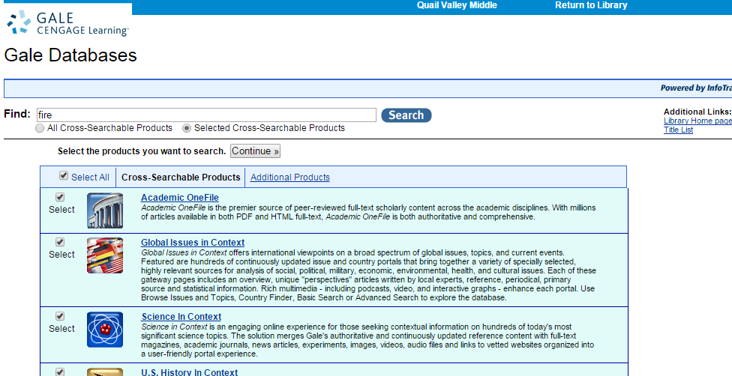
Using Gale Cengage to Find Images
Choose all products by entering term here.
Enter term here next to Find:

Slide 4
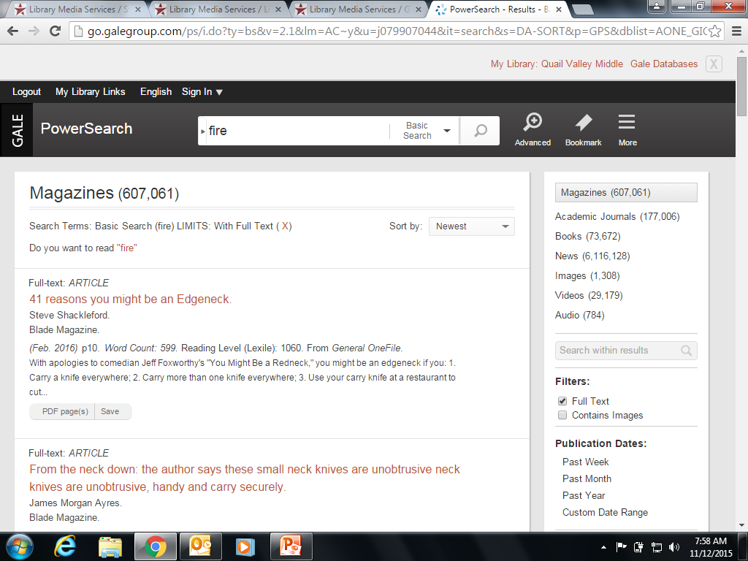
Using Gale Cengage to Find Images
Choose “Images” on left hand side.
Click “Images”

Slide 5
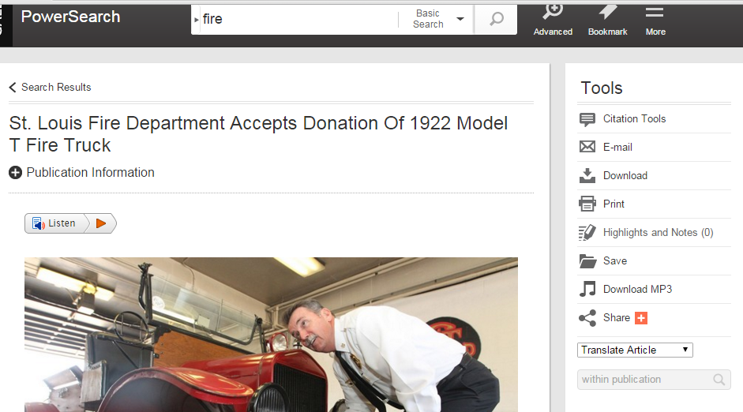
Using Gale Cengage to Find Images
When you choose a picture, get the citation by clicking “Citation Tools.” Yep, it gives you the citation!
Click “Citation Tools” and choose the MLA style citation.

Slide 6
Using Google Images to find “free use” pictures. For these, you will need to create the citation yourself!!!
Step 1: Enter a term into Google and choose “Images.”

Slide 7
Step 2: Choose “Search Tools” option, choose “Usage Rights,” and choose “Labeled for reuse” option. You will have to create the citation!!!!!!!!
1st: Click “Search Tools”
2nd: Choose “Usage Rights”
3rd: Choose “Labeled for reuse” option. You man now select pics.

Slide 8
Script DUE Friday!
A complete script will be due Friday in class so finish your script!!!! You will turn it in to turnitin.com.

