Slide 1
Photo Story 3 for Windows
Find Photo Story 3 for Windows in “All Programs” in the Start menu.
Click “Begin a new story” if you are just starting.
Click “Edit a project” if you’ve already begun.

Slide 2
Import Your Pictures
After saving your slides as separate jpegs in a folder, click “Import Pictures” to import them into your Photo Story.
You can change the order of the slides by clicking them and dragging them.

Slide 3
“Save Project…” Right Away
Click “Save Project…” and save your project file with your images. Make sure you know where you saved it.
Save your project under the file name found on the rubric so you won’t forget later!

Slide 4
Recording Narration
Narration will be recorded on each slide separately.
You can record narration before or after adding transitions and effects. Either way will work.
If the computer doesn’t recognize your mic, try closing Photo Story and then opening it again. Be sure the mic is plugged into the right jacks.
Click the red button to record, the square to stop, and the back arrow to delete and record again.

Slide 5
Applying Effects in Photo Story
At any point, click “Next >” whenever you are ready to advance to the next stage.
On this screen, you can apply effects, but it will apply the effects to everything in the picture.
Drop down menu for applying effects.

Slide 6
Customize Motion (add transitions)
Click “Customize Motion…”
Then click “Transition” tab.
Click the “Transition” tab
Customize Motion….

Slide 7
Customize Motion: To Stop the Picture and Text from Moving!
Photo Story zooms in and out or moves from one side to another. Sometimes this makes the text or picture hard to read or see. If you don’t want this motion, do the following:
1) Choose the “Motion and Duration” tab.
2) Choose “Specify start and end position of motion” option. Drag both pictures so they cover the entire slide space as shown here.

Slide 8
Choose transitions for each slide.
Choose and save transitions for each slide.
You may preview them by clicking “Preview.”
Scroll here to choose different transitions.
Click here to preview.
Save each transition.

Slide 9
Skip “Add Background Music”
Just click “Next >”

Slide 10
When you’re absolutely done with your Photo Story…
Follow these instructions to finalize and convert it into a WindowsMediaVideo (.wmv) file.
First, be sure you saved it as a project. Then convert:
1) Choose “Save your story for playback on your computer.”
2) Browse to save it in the appropriate folder. Name the file as per the rubric before saving.
3) Click “Next >” and wait for file to convert. ☺

Slide 11
Now preview your wmv file and then upload it to the Raider drive in the “Bernhart 1” folder where you will find a “Digital Literary Analysis” folder inside. Follow the instructions on the next slide to compete this process successfully. ☺

Slide 12
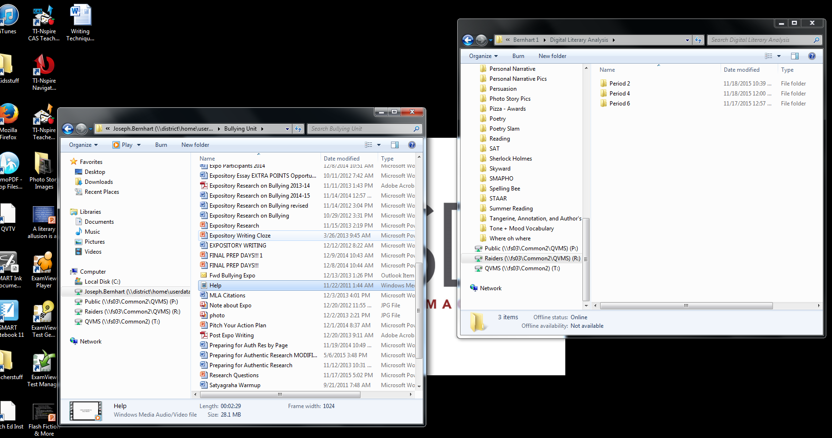
Drag to save on Raider drive.
In order to get the file in the Raider drive, you must open side by side windows and drag the file into the Raider drive. If you do not, your file will be 0KB, meaning it’s not there even though the title is…
Folder with my DLA file
(in my student drive).
Drag file across into here!
Drag the file from this folder into the Raider drive folder
“Bernhart 1” folder in Raider drive.

